Slide 1

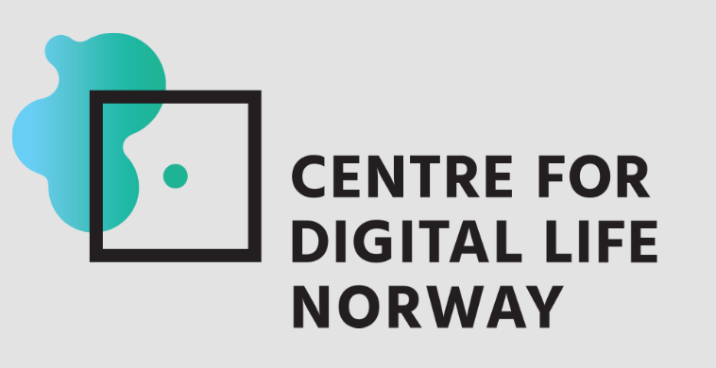
Technologies for Digital Life - Radisson Blu Royal Hotel, Bryggen, Bergen, 21.10 2016, 14:00-14:15
https://www.ntnu.no/dln/technologies-for-digital-life
In vivo imaging and image analysis
Prof. Arvid Lundervold BSc, MD, PhD
Department of Biomedicine, University of Bergen &
Department of Radiology, Haukeland University Hospital, Bergen, Norway
http://github.com/arvidl/computational-medicine

Slide 2

The Centre for Digital Life Norway (DLN) aims to drive the development of a new branch of Norwegian biotechnological research and innovation, by mixing life scientists, mathematicians, statisticians, computer scientists and engineers.
This will be a key ingredient to scale up the success of generating predictive models of biological systems – by using many different types of technologies and methodologies.
How can we best integrate different technologies and methodologies
in transdisciplinary research projects?
Are we equipped for this type of research?
How does “In vivo imaging & image analysis” fit in ?
+ live imaging acquisition + image-based modelling
CONCEPTS
TRENDS
INFRASTRUCTURE
SOLUTIONS

Slide 3
Predictive models of biological systems
CONCEPTS
Development and use of algorithms, data structures, visualization and communication tools with the goal of computer modelling of biological systems.
Includes stochastic and deterministic computer simulations and machine learning
from biological measurements: -omics, images … Has a broad mathematical foundation.
When deployed commercially, predictive modelling is often referred to as predictive
analytics ( extracting information from data and using it to predict trends and system behavior patterns )
Wikipedia
Transdisciplinary research = team science
In a transdisciplinary research endeavor, scientists contribute their unique expertise but work outside their own discipline.
Strive to understand the complexities of the whole project, rather than one part of it.
Allows investigators to transcend their own disciplines to inform one another’s work, capture complexity, and create new intellectual spaces.
http://www.obesity-cancer.wustl.edu/en/About/What-Is-Transdisciplinary-Research

Slide 4

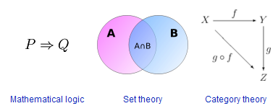

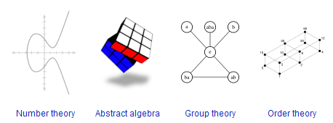
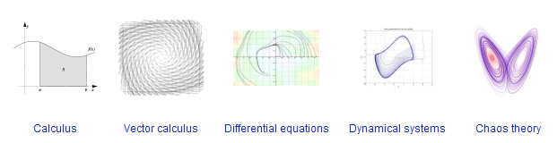
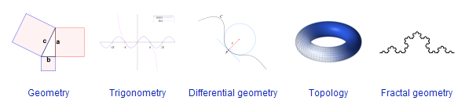
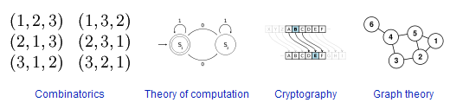
Mathematics is the body of knowledge centered on
concepts such as
quantity, structure, space, and change, and
the academic discipline which studies them …
CONCEPTS
FOUNDATIONS
… being instrumental in predictive models of biological systems and “Digital Life”
Mathematical
logic
Set theory
Category theory
STRUCTURE
CHANGE
Number theory
Abstract
algebra
Group theory
Order theory
Calculus
Vector calculus
ODEs/PDEs/SDEs
Dynamical systems
Chaos theory
SPACE
DISCRETE MATHEMATICS
Geometry
Trigonometry
Differential
geometry
Topology
Fractal geometry
Combinatorics
Theory of
computation
Cryptography
Graph theory

Slide 5
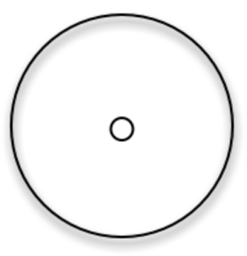
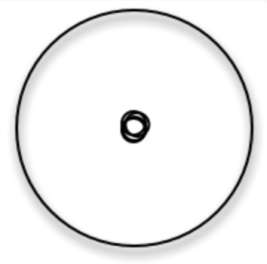
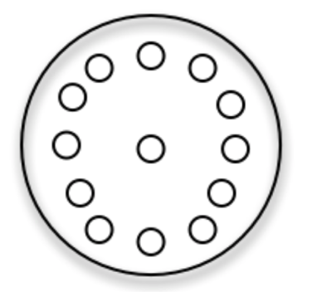
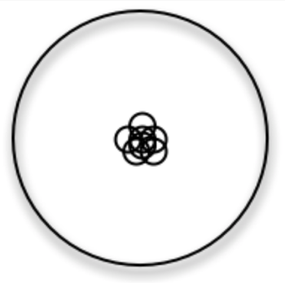
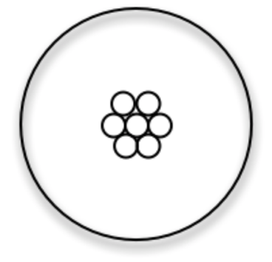
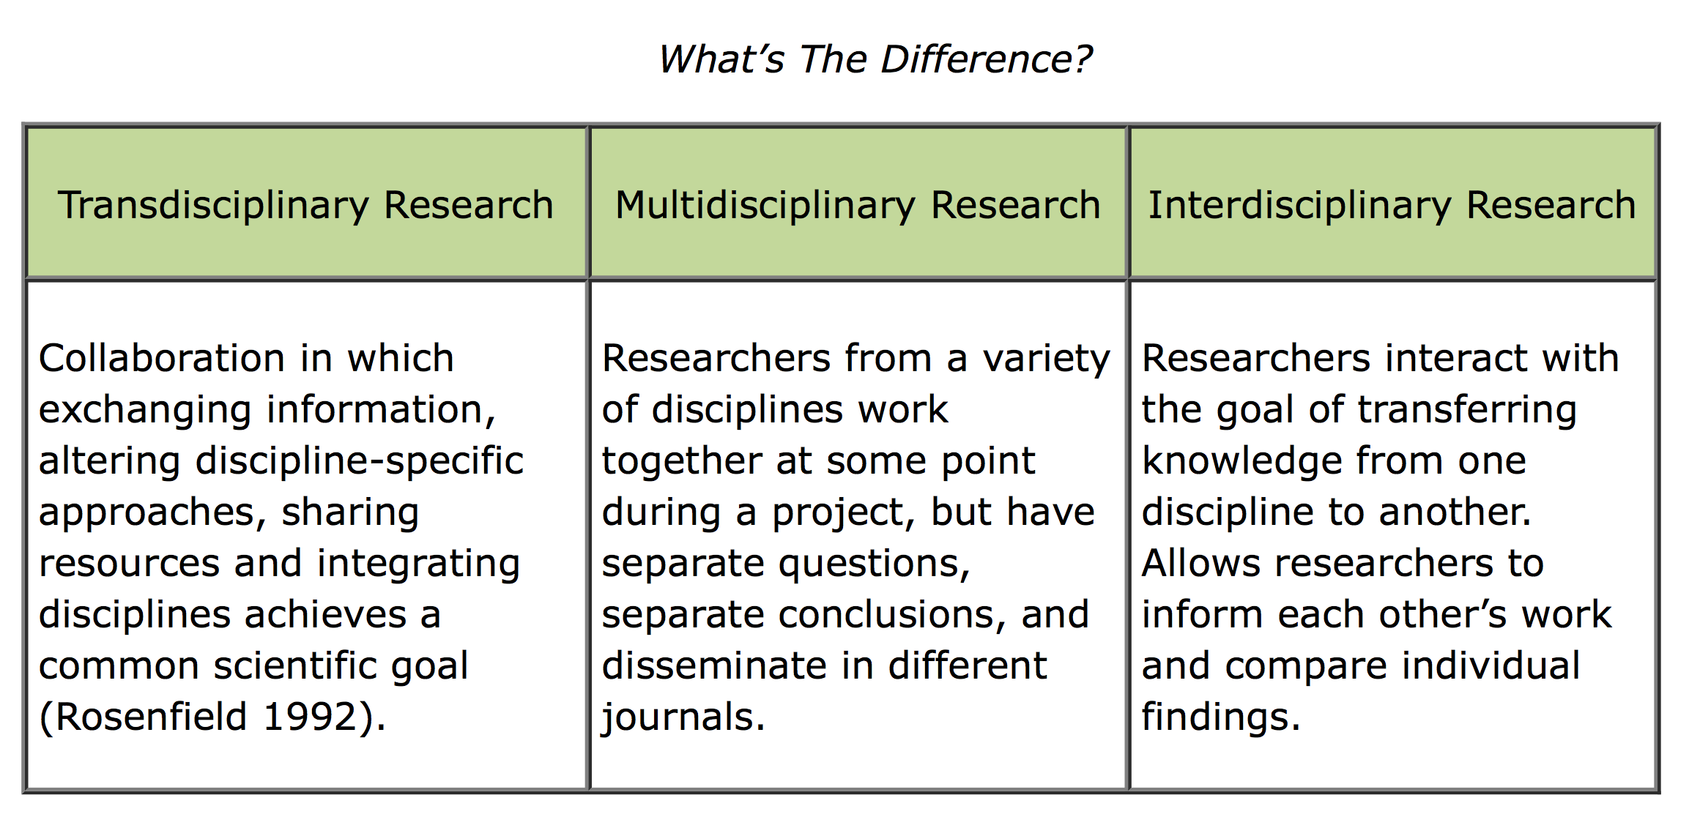
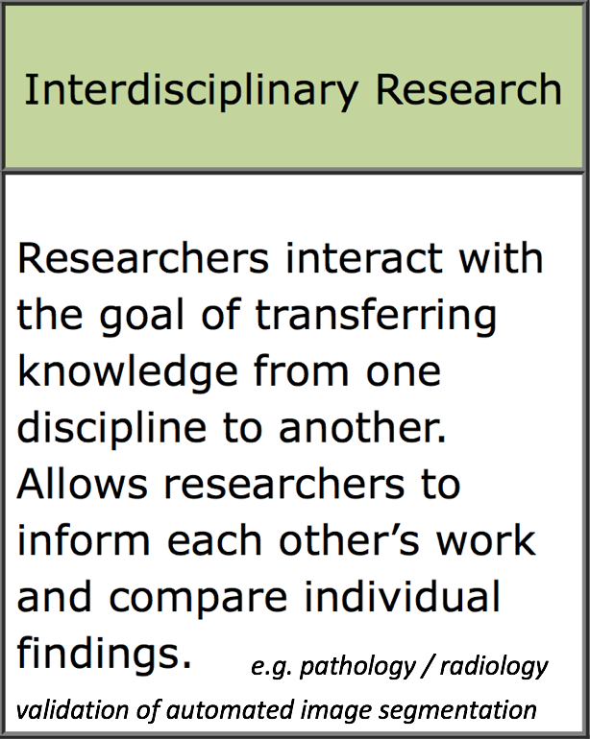


Washington University in St. Louis
- Transdisciplinary
- Multidisciplinary
- Interdisciplinary
- Crossdisciplinary
CONCEPTS
What is the difference?
research
( Intradisciplinary )
Crossdisciplinary Research
Researchers are viewing one discipline from the perspective of another.
e.g. Digital Life in transition to
transdisciplinary research ?
e.g. pharmacokinetic modeling from DCE-MRI
measurements for assessment of tumor physiology
e.g. multimodal
e.g. image co-registration and segmentation
validation of automated image segmentation
http://www.obesity-cancer.wustl.edu/en/About/What-Is-Transdisciplinary-Research
http://www.arj.no/2012/03/12/disciplinarities-2

Slide 6
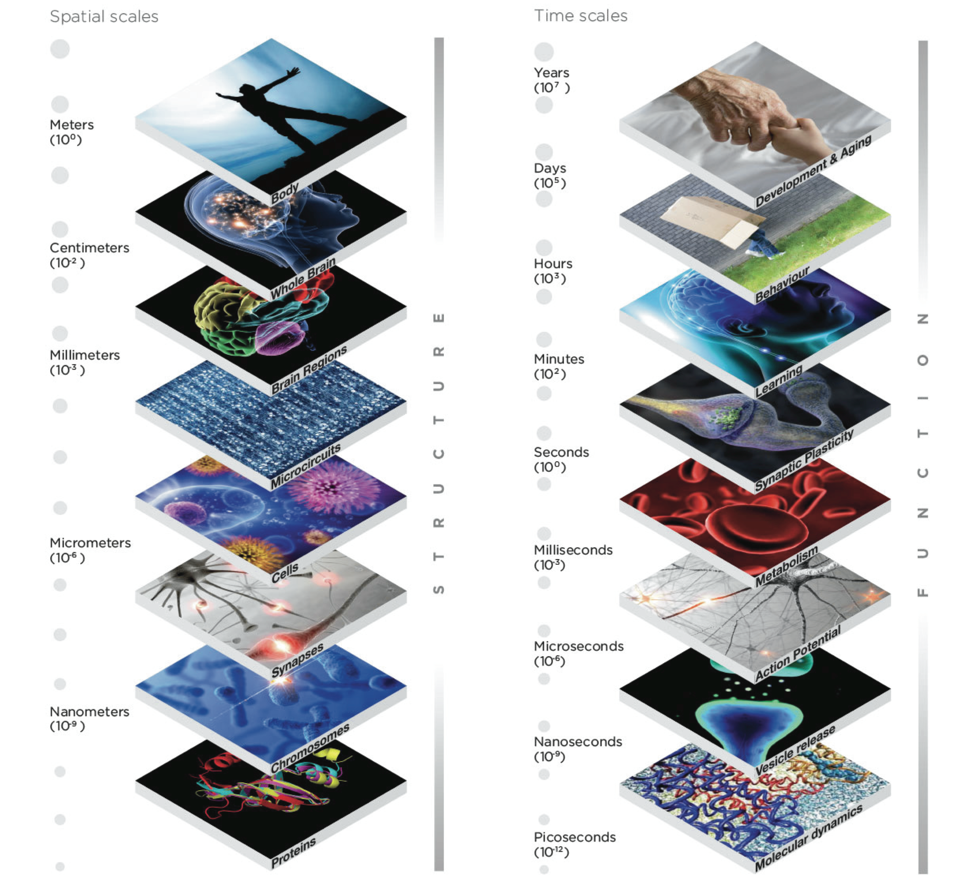
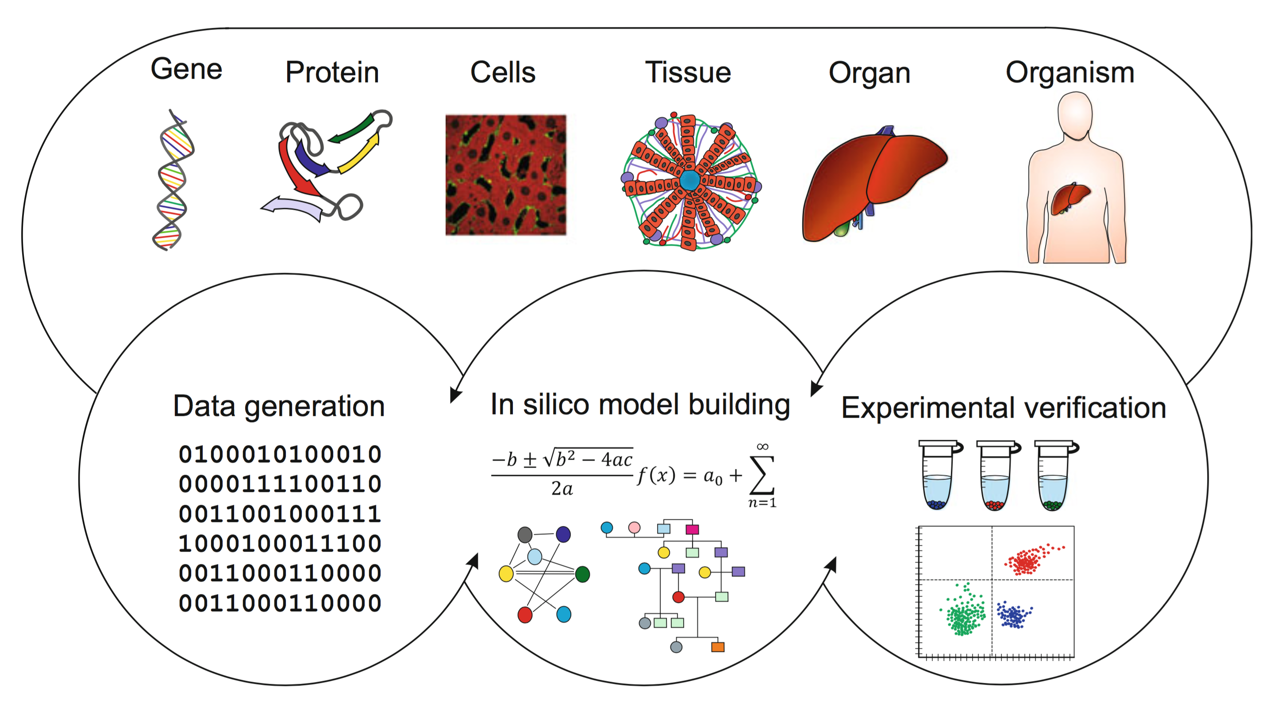
TRENDS
Systems biology & medicine and computational imaging
MULTISCALE
Spatial scales
Time scales
S T R U C T U R E
F U N C T I O N
Ulf Schmitz, Olaf Wolkenhauer (eds) Systems Medicine, Springer, 2016
https://www.humanbrainproject.eu

Slide 7
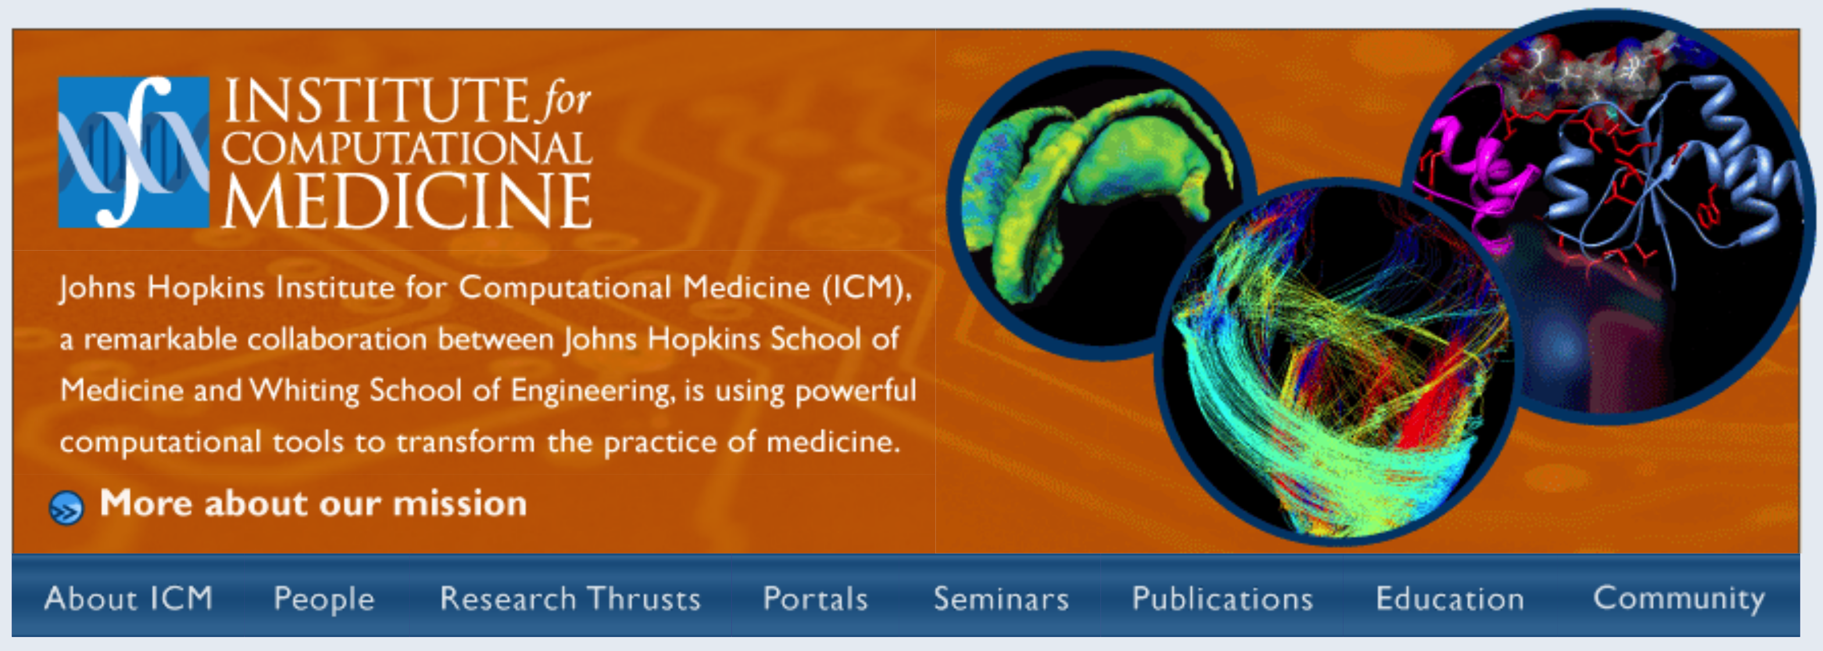
TRENDS
Computational Medicine
It will soon be common for clinical research studies to:
Collect genetic, transcriptional, proteomic, imaging and clinical data from every patient in large, carefully selected cohorts sharing a specific disease diagnosis.
Johns Hopkins University
The challenge of the coming decade will be
- how best to use these multi-scale biomedical data
- to gain a quantitative understanding of disease mechanisms
- across hierarchical levels of biological organization
- to identify biological markers which correlate with different disease states
- and inter-individual differences in disease risk
Discover more effective therapeutics targeted to the individual
http://www.icm.jhu.edu

Slide 8
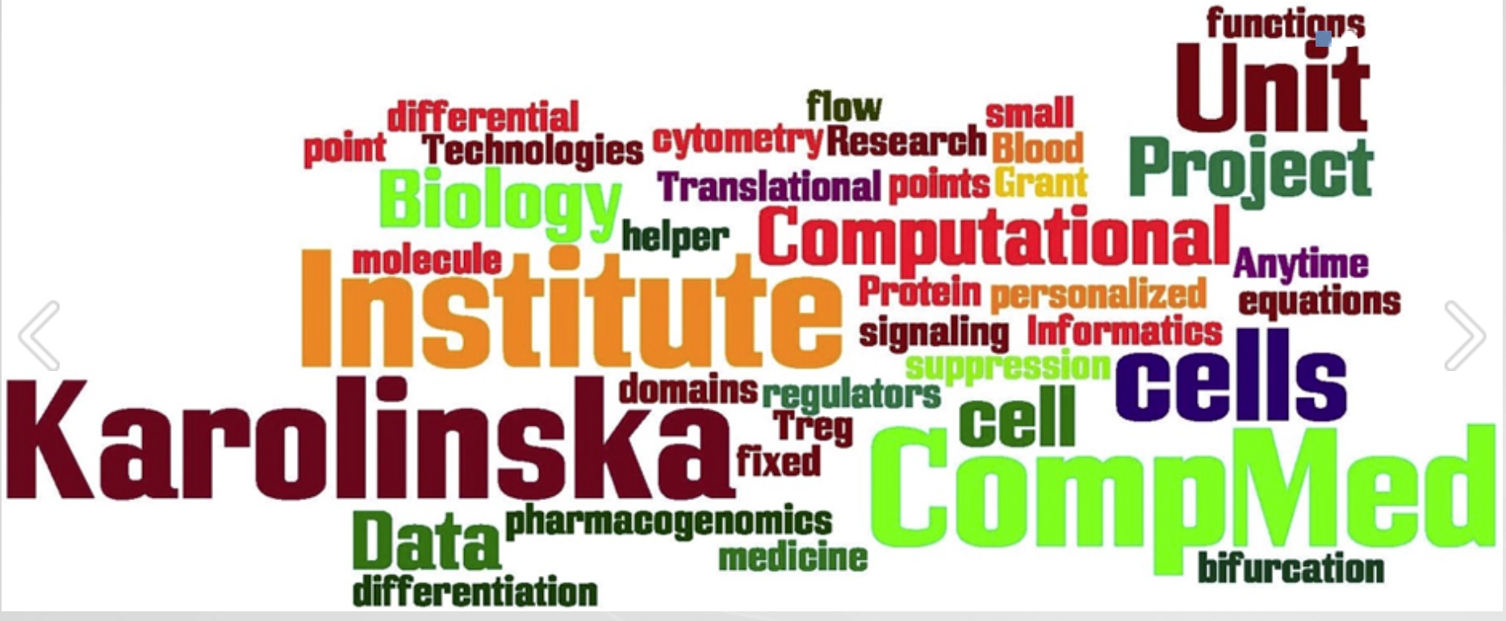

TRENDS
Unit of Computational Medicine - Karolinska Institutet
Uniquely integrated multidisciplinary team of more than 30 scientists from
- pure and applied mathematics
- immunology
- physics
- midwifery
- complexity theory
- cell and molecular biology
- computer science
- pharmacology
- engineering
- medicine
develop and apply integrative
computational-experimental approaches
provide fundamental insights of
life beyond physics
enable prediction, prevention and
treatment of diseases
http://www.compmed.se

Slide 9
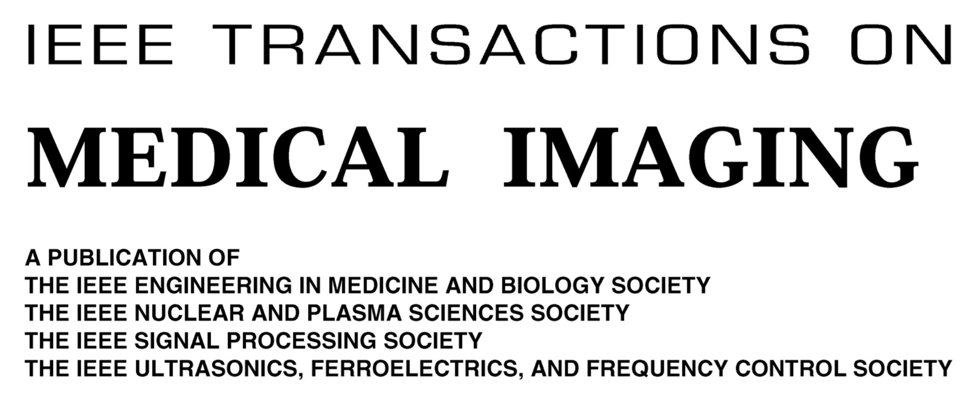
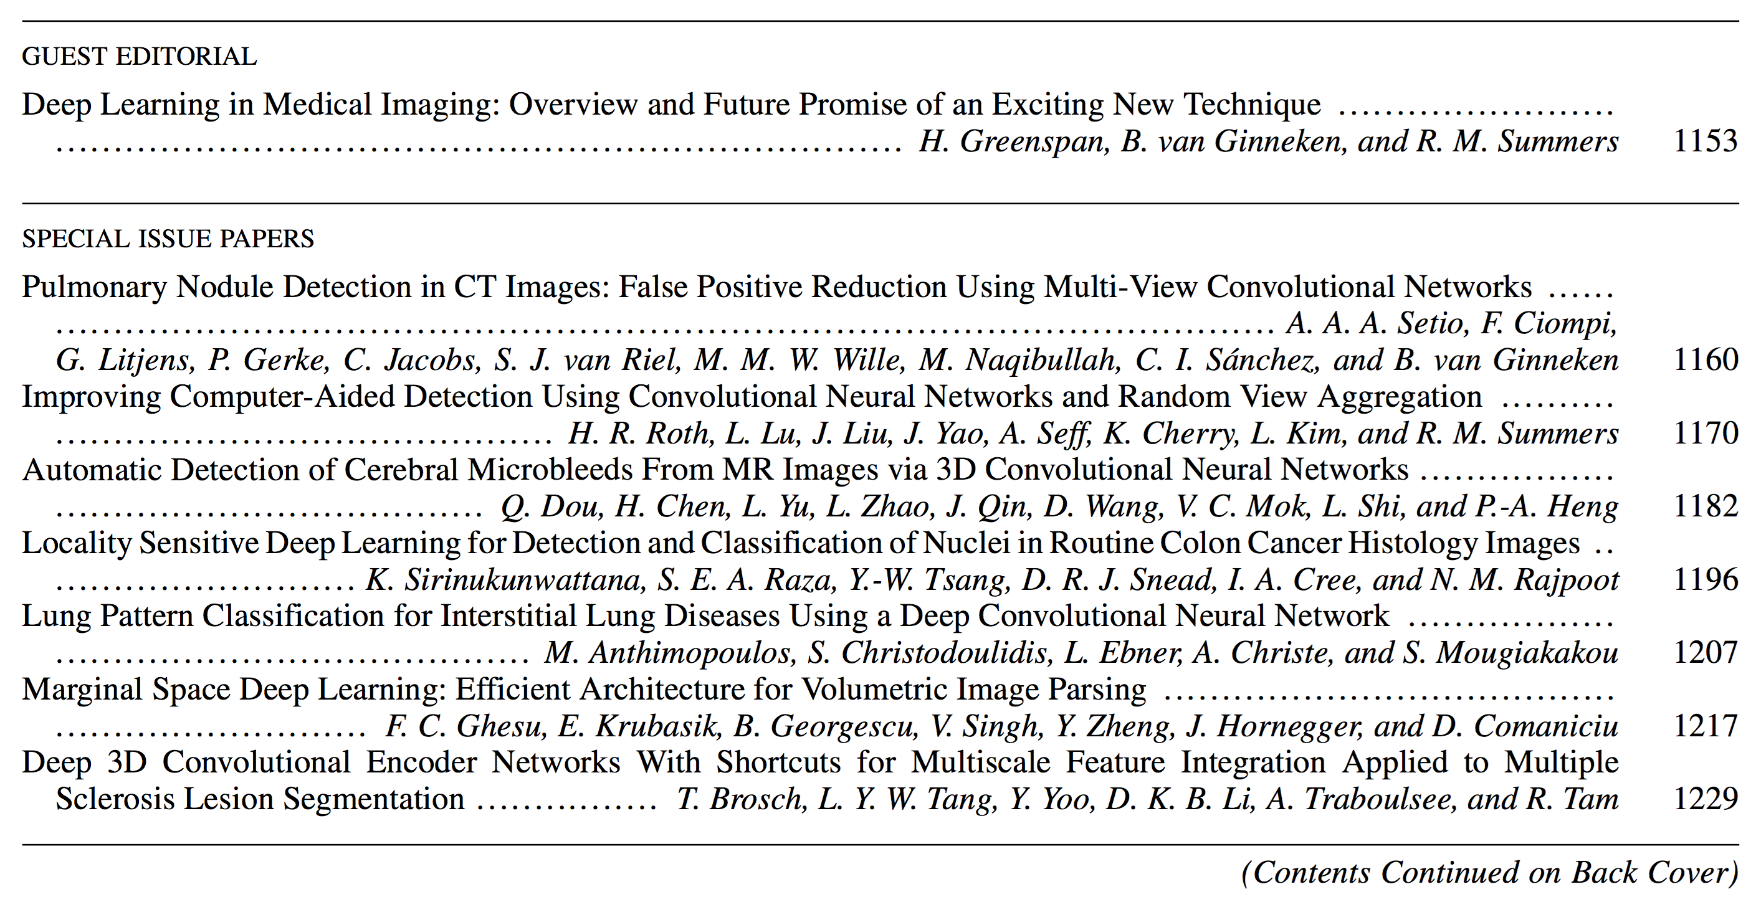
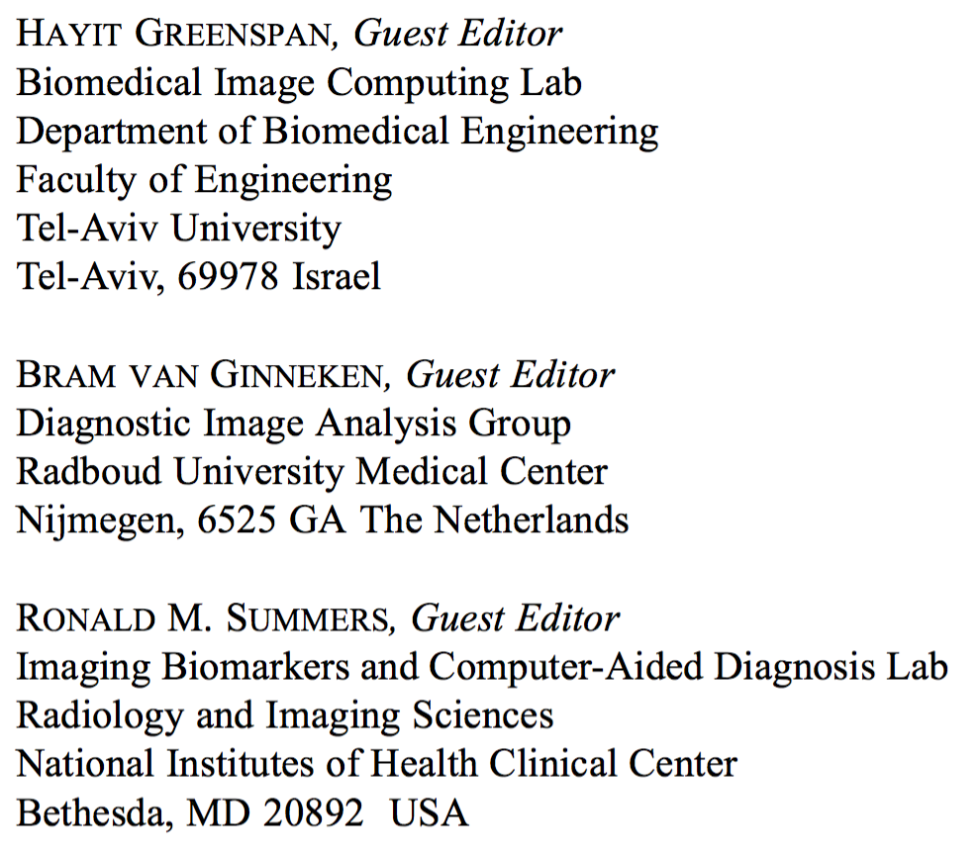
TRENDS
Data analytics - Machine learning
Deep learning is a growing trend in general data analysis and has been termed one of the 10 breakthrough technologies of 2013 [1]. Deep learning is an improvement of artificial neural networks, consisting of more layers that permit higher levels of abstraction and improved predictions from data [2]. To date, it is emerging as the leading machine-learning tool in the general imaging and computer vision domains.

Slide 10
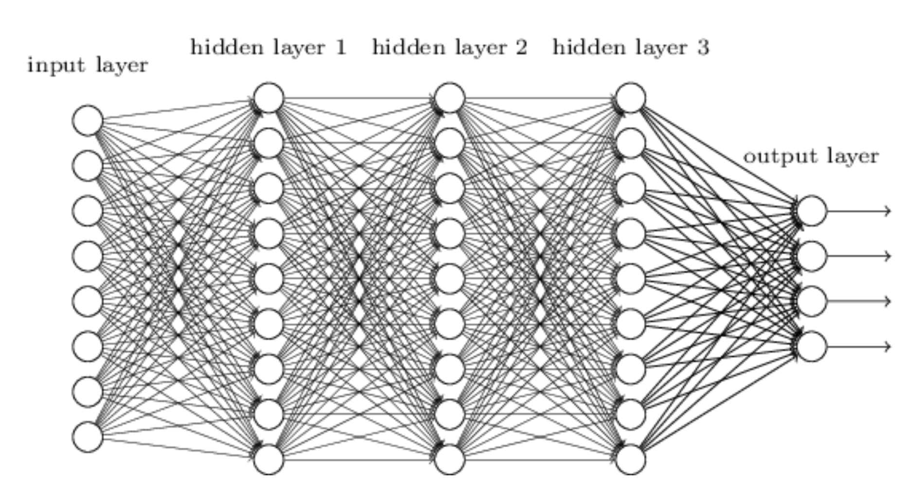
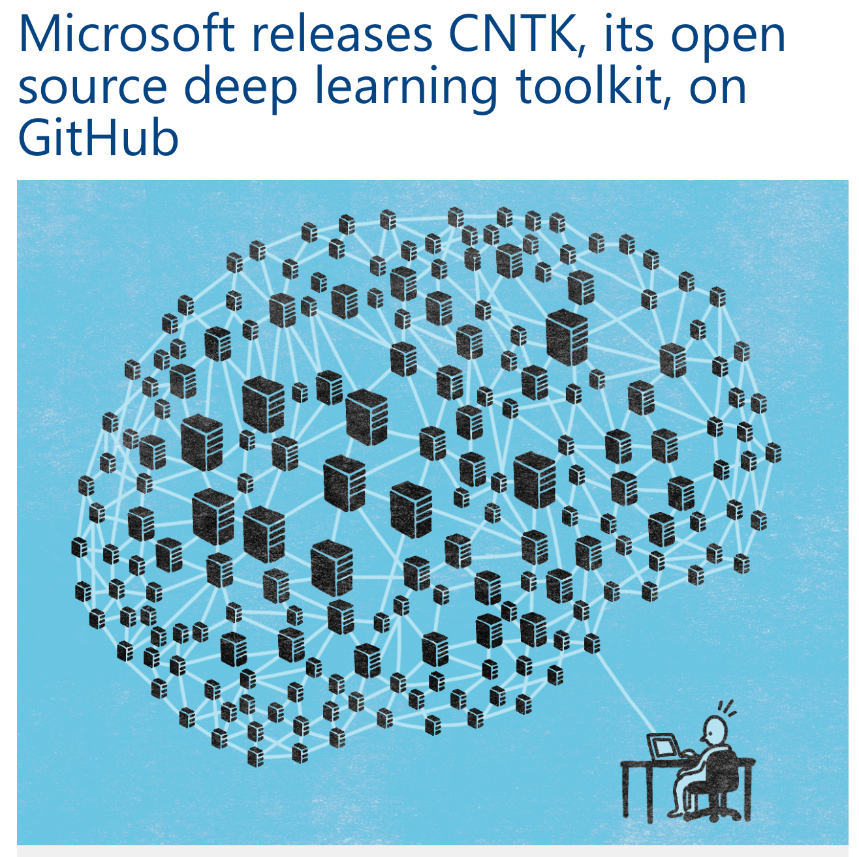
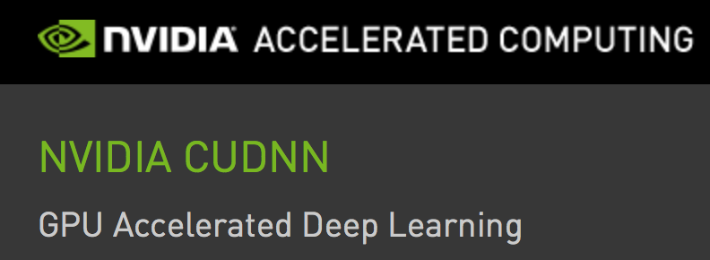
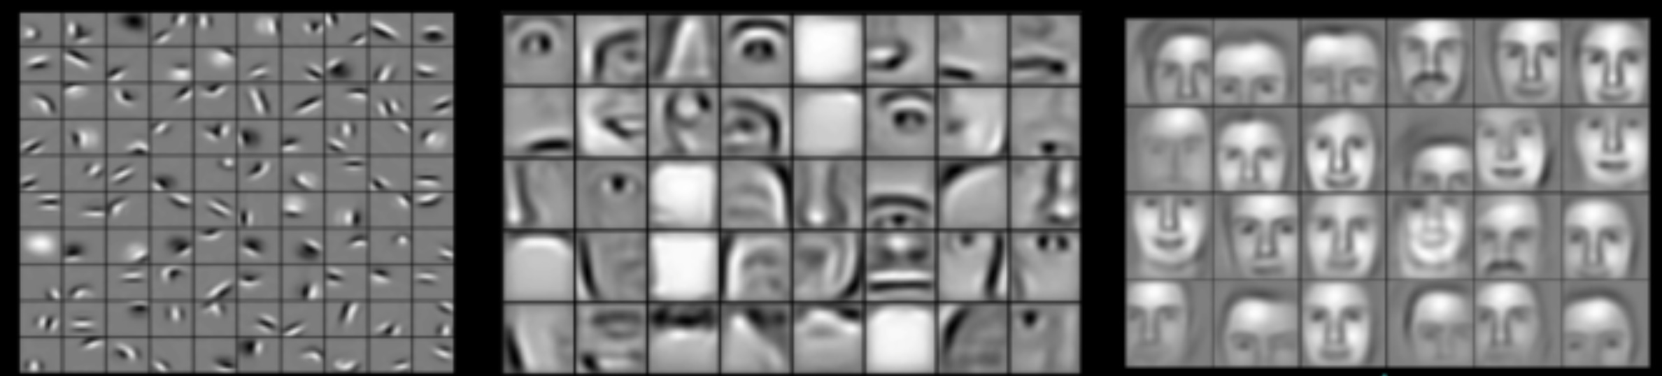

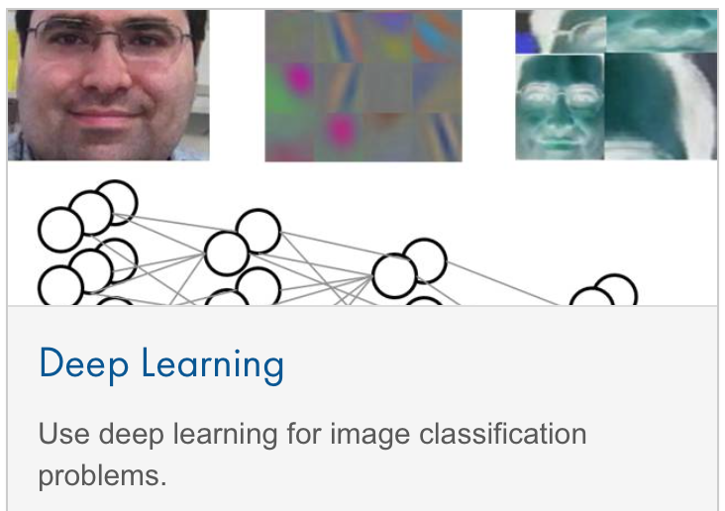
Neural networks - deep learning
TRENDS
Deep learning is a branch of machine learning based on a set of algorithms that attempt to model high-level abstractions in data by using multiple processing layers, with complex structures or otherwise, composed of multiple non-linear transformations
Input layer
Hidden layer 1
Hidden layer 2
Hidden layer 3
Output layer
Wikipedia
l a y e r s o f f e a t u r e s
Notes:
Functional MRI voxel time courses and spatio-temporal activity patterns

Slide 11



TRENDS
June 2016
https://www.wired.com/2016/05/the-end-of-code/

Slide 12
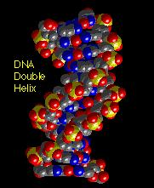
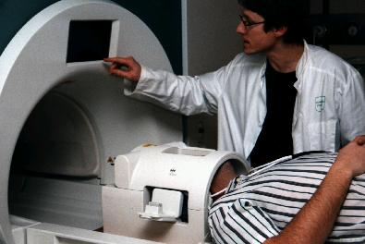
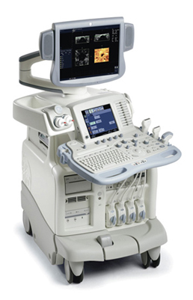
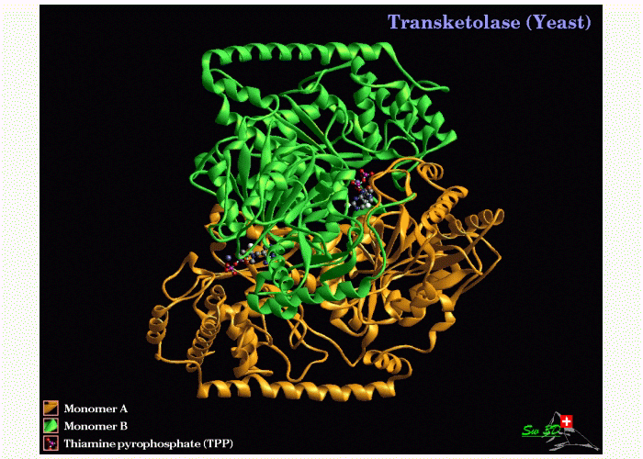
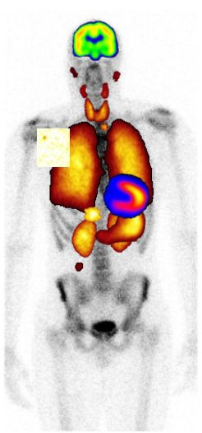
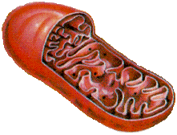
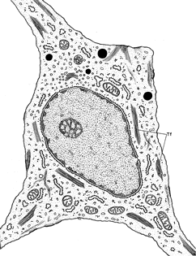
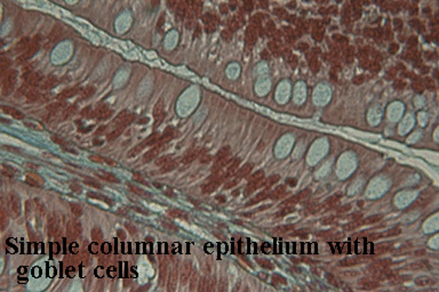
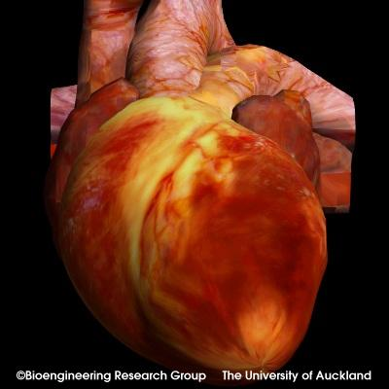
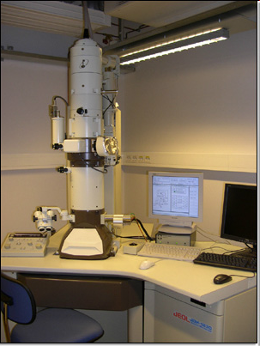
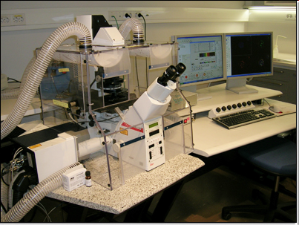
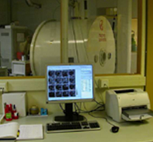

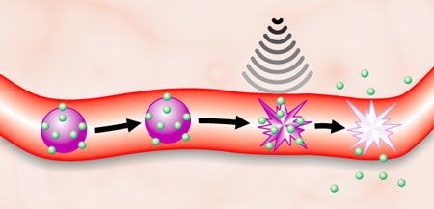
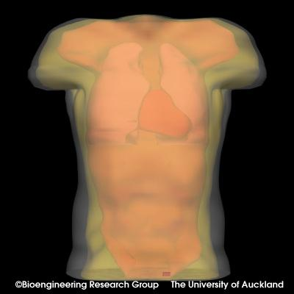
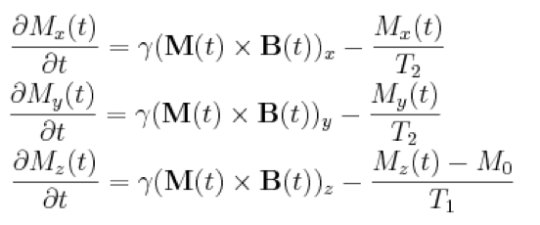
Imaging infrastructure (in Bergen)
INFRASTRUCTURE
Superresolution microscopy (STED)
MRI experts ( acquisition + analysis )
- New visualization center from 2017
DNA
Clinical MRI
Clinical US
Protein
Clinical PET/CT
Organelle
Cell
1 GE + 2 x Siemens 3 Tesla
Tissue
Microscopy
EM
Organ
Confocal
Animal MRl
Organism
7 Tesla Bruker Pharmascan

Slide 13
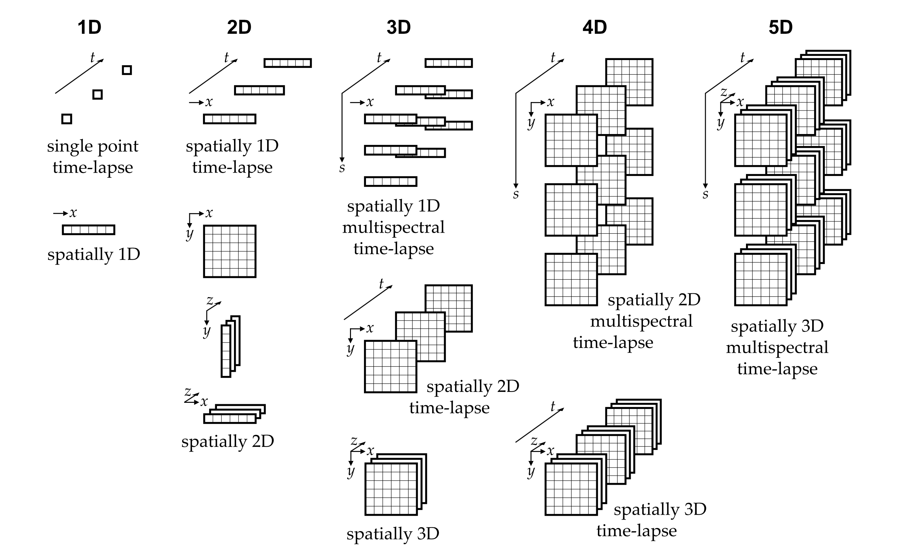
Images as matrices
CONCEPTS
1D
2D
3D
4D
5D
From: Erik Meijering and Gert van Cappellen,
Biological Image Analysis Primer, 2006
http://www.imagescience.org/meijering/publications/download/biap2006.pdf

Slide 14
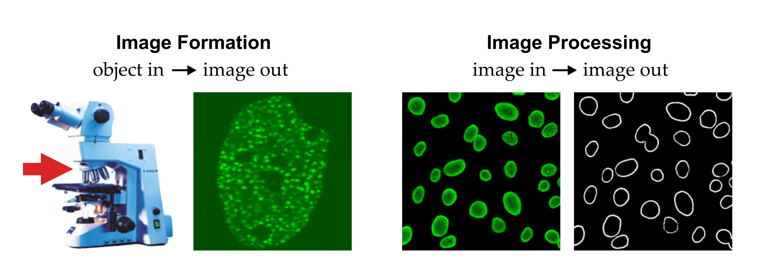
“Image formation” vs. “Image processing”
CONCEPTS
From: Erik Meijering and Gert van Cappellen,
Biological Image Analysis Primer, 2006
http://www.imagescience.org/meijering/publications/download/biap2006.pdf

Slide 15
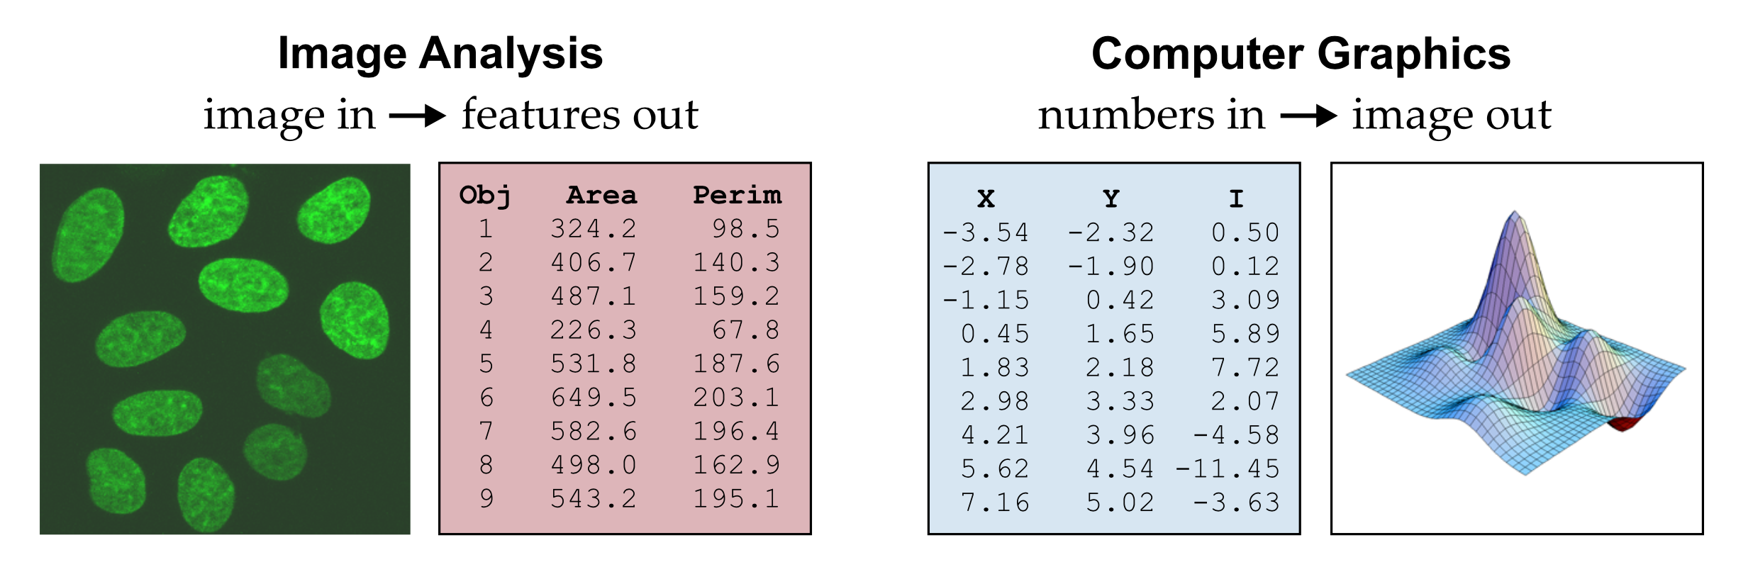
“Image analysis” vs. “Computer graphics”
CONCEPTS
From: Erik Meijering and Gert van Cappellen,
Biological Image Analysis Primer, 2006
http://www.imagescience.org/meijering/publications/download/biap2006.pdf

Slide 16
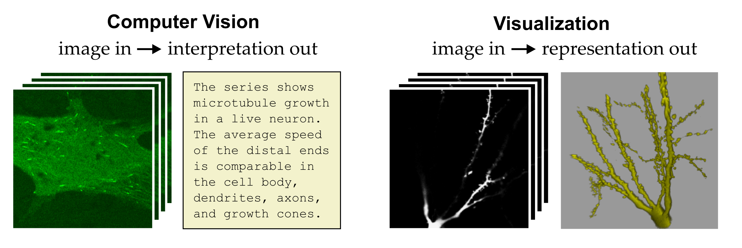
“Computer vision” vs. “Visualization”
CONCEPTS
( Image understanding )
From: Erik Meijering and Gert van Cappellen,
Biological Image Analysis Primer, 2006
http://www.imagescience.org/meijering/publications/download/biap2006.pdf

Slide 17
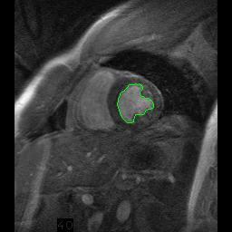
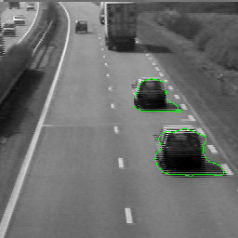
Modeling and image analysis can be generic in nature
SOLUTIONS
(“active contours”)
Medical MR imaging
Surveillance engineering

Slide 18
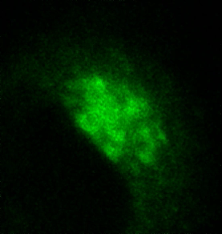

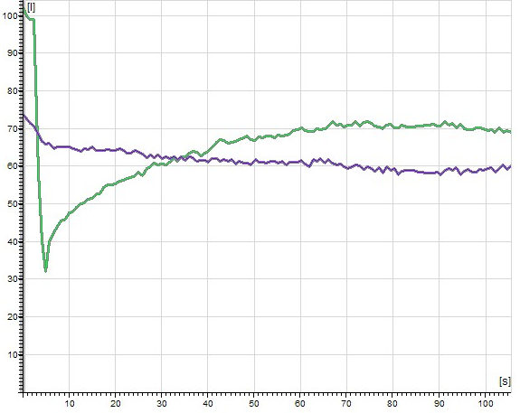
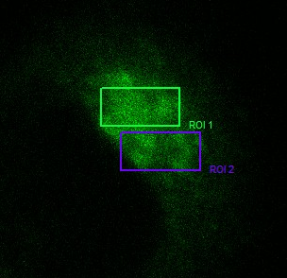
Live cell imaging: FRAP – Fluorescence Recovery After Photobleaching
SOLUTIONS
Measure the dynamics of a molecule over time (diffusional mobility) and chemical changes of molecular species
Bleached are
Image-based
modelling:
2-compartment model
O - organelle-associated protein
C - cytoplasmic protein
ROI1
dO
= k_{in} C – k_{out} O
Photobleaching of GFP in the Golgi area (ROI1) with a high intensity laser.
The recovery of fluorescence in the bleached area is followed.
d t
ROI2
dC
= k_{out} O – k_{in} C
% fluorescence
d t
k_{x} – reate constants
Time (s)

Slide 19
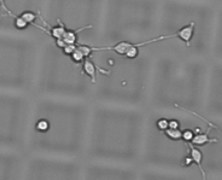








Object tracking
Performance evaluation
SOLUTIONS
Automatically segmented and tracked
Time
Ground truth
StemCells_amalka_uppsala_thesis_paper1.avi
”Easy” - ”Toy problem ”
” Intracellular transport vesicles ”
Difficult:
occlusion is
handeled

Slide 20



SOLUTIONS
Multi-parametric MRI and histopathological examinations of a prostate (brown circle) with tumor (blue circle).

Slide 21







Automated brain tissue classification - kNN
SOLUTIONS
k=7 Nearest Neighbor classification
to six different tissue types of the human head
z
R³
FISP
y
x
DESS
FLASH
⇧
Classification of new voxels based on a training set (mask)
made by an expert (supervised learning):
Air
Grey matter
White matter
CSF
Muscle
Fat

Slide 22





The role of numerical libraries,
operating systems and versions
CONCEPTS
Imagine you’re doing a study comparing brain structure in two groups. Halfway through analyzing your data, you upgrade your MacOS. All of the brains you analyze after that will be, say, 5% “bigger”. That’ll certainly make your data much noisier, and if you happen to analyze most of Group A before Group B, it’ll give you a false positive finding.

Slide 23


Reproducible research – Open Science – Open source
TRENDS
/
SOLUTIONS
Computational (bio)medicine
& Software development
Example
” Build software better, together "

Slide 24




Paper
SOLUTIONS
Code
https://github.com/ehodneland/cellsegm
An automated MATLAB tool for segmentation of surface stained cells.
Test-
data
Sourcecode
Examples
Testdata

Slide 25









The future of bio(medical)imaging and imaging-based modeling…
SUMMARY
LIVE / IN VIVO IMAGING, SYSTEMS BIOLOGY and SYSTEMS MEDICINE
TRANSDISCIPLINARITY and COMPUTATIONAL APPROACHES
to the multi-scale nature of molecules, cells, tissues and organs in health and disease
Addressing
the challenges:
Δ mindset
Δ skillset
Δ toolset
SPACE:
Atom
10⁻¹² m
Protein
10⁻⁹ m
Cell
10⁻⁶ m
Tissue
10⁻³ m
Organ
10⁰ m
Anatomy
Organ system
& organism
Physiology
Brain
Spinal
cord
Peri-
pheral
nerves
Gene
networks
Pathway models
Stochastic models
Ordinary
Differential
Equations
Continuum models
(Partial Differential
Equations)
Systems models
- open science
- reproducible
research
TIME:
10⁻⁶ s
molecular events
(ion channel gating)
10⁻³ s
diffusion
cell signalling
10⁰ s
motility
10³ s
mitosis
10⁶ s
protein
turnover
10⁹ s
human
lifetime
From: C. Dollery and R. Kitney, Systems biology: A vision for engineering and medicine, Tech. report, The Academy of Medical Sciences and The Royal Academy of Engineering, London, UK, Feb. 2007.

